Slide 1


Revozon Technology
Secure Cross-Border Technology Services for Global Partners
We help international partners fund, manage, and receive technology-enabled services through a transparent, secure, and professionally managed digital workflow.
CLICKABLE PROTOTYPE
UNIONPAY-READY
COMPLIANCE-FIRST
CHINA ⇄ PAKISTAN · GLOBAL
Partner demonstration · Investor review · Product validation — August 2026
Notes:
Revozon Technology: platform for funding, managing and receiving verified technology services across borders. Prototype covers public site, partner portal, admin dashboard, and UnionPay-ready payment workflow.

Slide 2





THE PLATFORM
Every engagement is funded, documented, and verified
Revozon coordinates legitimate business-service payments between international partners and delivery teams — with formal invoicing, compliance review, and transparent project tracking at every stage. Not a money-transfer service: an invoice-based service-payment workflow.
Invoice-Based Deposits
Compliance Review
Transparent Tracking
Verified Completion
Every deposit is tied to a formal invoice with service description, currency, tax notes, and due date.
KYC/KYB verification, AML screening, and documentation checks on every partner and payment.
Milestone-level project visibility, delivery files, and approval loops inside the partner portal.
Receipts, completion certificates, and downloadable records generated on final approval.
Positioning: Revozon Technology enables trusted international partners to fund, manage, and receive verified technology services through secure invoicing, compliant payment coordination, and transparent project delivery.
REVOZON TECHNOLOGY · Prototype documentation — no real payment processing
02

Slide 3




HOW REVOZON WORKS
Four steps from onboarding to verified delivery
1
2
3
4
Register & Verify
Agree Scope & Invoice
Deposit via Approved Channel
Track & Approve Delivery
→
→
→
Create a partner account, upload company documents, complete KYC/KYB compliance review.
Confirm services, timeline, and price. Revozon generates a digital agreement and formal invoice.
Fund the invoice through UnionPay, wire, or an approved gateway. Finance verifies receipt.
Follow milestones in the portal, review deliverables, receive completion certificates.
⚖ Compliance-first: delivery begins only after funds are verified through approved payment channels with proper documentation, tax review, KYC/KYB and AML screening.
REVOZON TECHNOLOGY · Prototype documentation — no real payment processing
03

Slide 4









SERVICES
Delivered against confirmed invoices
Software Development
8–16 wks
Web & Mobile Apps
6–14 wks
AI Automation
4–12 wks
Cloud Infrastructure
4–10 wks
Cybersecurity Consulting
2–8 wks
IT Support & Managed Services
Ongoing
Business Process Outsourcing
Ongoing
Digital Marketing
4–12 wks
Data & Analytics
6–12 wks
Local Operational Support
Per scope
Each engagement begins with a defined scope, a digital agreement, and a formal invoice — then moves into milestone-tracked delivery. Timelines are placeholders.
REVOZON TECHNOLOGY · Prototype documentation — no real payment processing
04

Slide 5
CHINA PARTNER WORKFLOW
Payment & service fulfillment — ten auditable stages
1
Partner Registration
6
Payment Verification
Account, company details, authorized contact, terms
Finance verifies receipt · compliance check · wallet credited
2
KYC / Business Verification
7
Service Delivery Begins
Registration docs, license, representative, compliance
Team starts, milestones created, portal tracking live
3
Service Scope Agreement
8
Milestone Review
Proposal → scope, timeline, price → digital agreement
Submit → review → Approve / Revision Required loop
4
Invoice Generation
9
Completion & Settlement
Formal invoice: amount, currency, tax notes, due date
Final approval → receipt + completion certificate
5
Payment Deposit
10
Reporting & Support
UnionPay / wire / approved gateway → Pending Verification
Download all documents · ongoing support tickets
Highlighted stages 5–6 are the payment core: deposit through approved channels, then verification before any delivery begins.
REVOZON TECHNOLOGY · Prototype documentation — no real payment processing
05

Slide 6
DEPOSIT LIFECYCLE
Explicit, auditable payment states at every moment
Invoice issued
Payment submitted
Pending verification
Verified
Project balance
Example shown: deposit submitted via UnionPay, now awaiting finance verification and compliance review.
All payment states
DRAFT INVOICE
AWAITING PAYMENT
PAYMENT SUBMITTED
PENDING VERIFICATION
VERIFIED
FAILED
REFUNDED
PARTIALLY PAID
COMPLETED
⚠ Compliance note: all cross-border payments processed only through legally approved channels, with documentation, tax review, KYC/KYB, AML screening, and compliance with Chinese, Pakistani, and international financial regulations.
REVOZON TECHNOLOGY · Prototype documentation — no real payment processing
06

Slide 7
UNIONPAY 银联 INTEGRATION
How UnionPay attaches to the Revozon merchant system
1
Partner clicks “Pay with UnionPay” on invoice
UnionPay 银联
2
Backend → acquirer API · createOrder(invoice, amount, notifyUrl)
Key architecture facts
Redirect to UnionPay hosted checkout (UPOP) — card data never touches Revozon
Integration goes through a UnionPay-certified acquiring institution / PSP — never direct.
Acquirer issues merchant ID, signature keys, sandbox certification, settlement currency.
Card data stays on the gateway page — Revozon holds only order + status.
3
4
UnionPay network routes to issuing bank for authorization
5
Signed async notification → deposit becomes Pending Verification
API touchpoints
6
Finance re-confirms via queryOrder · compliance check
createOrder
invoice → payment order + redirect URL
notifyUrl webhook
signed async result → Pending Verification
7
Verified → project balance updated → delivery activated
queryOrder
finance re-confirmation before approval
refund / reversal
routed back through original transaction
8
T+n settlement file → reconciliation in finance dashboard
settlement file
daily reconciliation vs. invoices
REVOZON TECHNOLOGY · Prototype documentation — no real payment processing
07

Slide 8




PAYMENT ARCHITECTURE
Gateway-agnostic, integration-ready by design
Partner Portal
Invoice Engine
Payment Gateway
Bank / Processor
Onboarding · invoices · tracking
Agreements · tax notes · PDF
UnionPay-ready via certified acquirer
Approved channels only
Compliance Review
Finance Dashboard
Project Wallet
Delivery Module
KYC/KYB · AML · tax
Verification queue
Verified balances
Milestones · files · approval
Real payment APIs connect at the highlighted layer. No provider is hard-coded — the prototype marks every integration point in code.
REVOZON TECHNOLOGY · Prototype documentation — no real payment processing
08

Slide 9
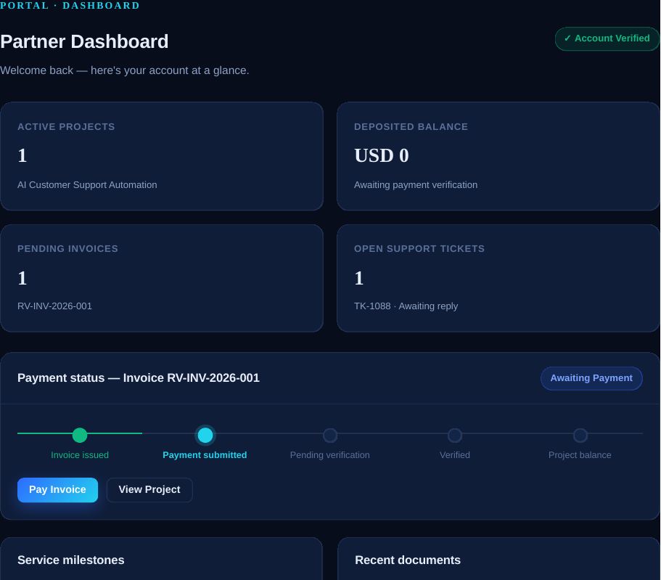
PRODUCT · PARTNER PORTAL
One verified workspace for partners
Dashboard
Balance, invoices, payment status, milestones at a glance
Invoices & Deposits
Formal invoices · UnionPay checkout · proof upload
Project Tracking
Scope, milestones, delivery files, approval loop
Documents
Agreements, receipts, certificates, tax records
Support
Tickets with category, priority, and threads
Prototype screenshot — Shanghai Service Group Ltd. (mock data)
REVOZON TECHNOLOGY · Prototype documentation — no real payment processing
09

Slide 10
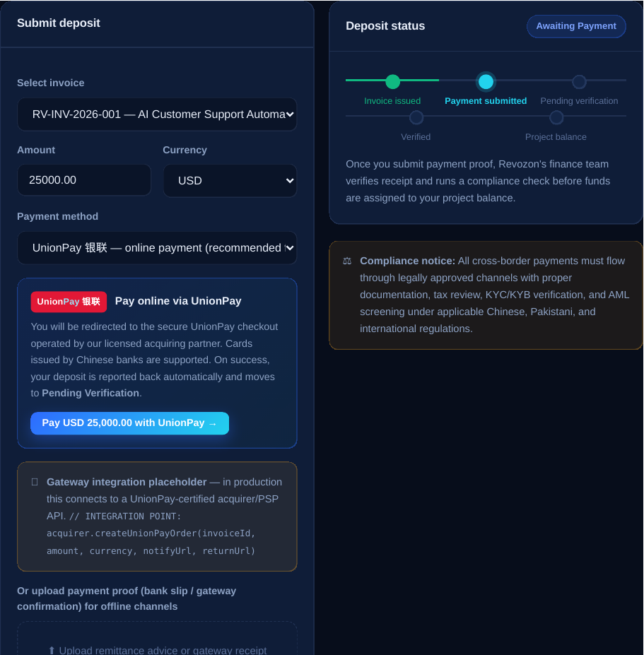
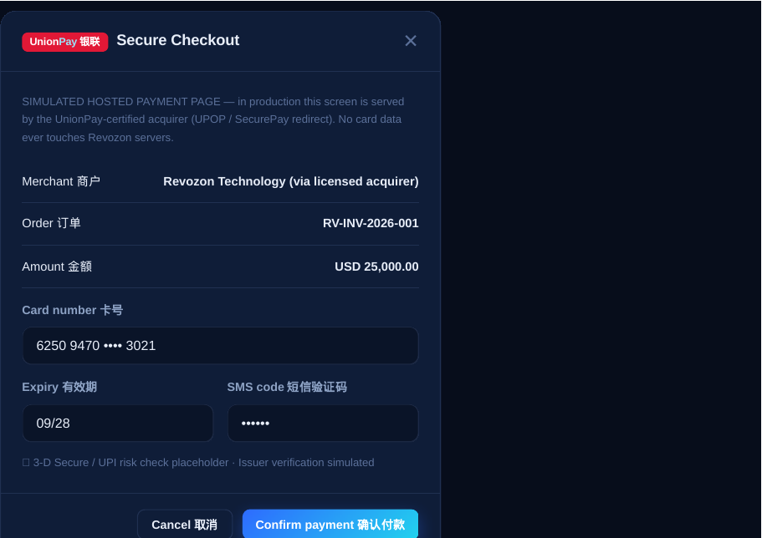
PRODUCT · PAYMENT DEPOSIT
UnionPay checkout embedded in the deposit flow
Deposit screen: invoice, currency, method, gateway block, proof upload
Simulated UnionPay hosted checkout (UPOP) — bilingual EN / 中文
REVOZON TECHNOLOGY · Prototype documentation — no real payment processing
10

Slide 11
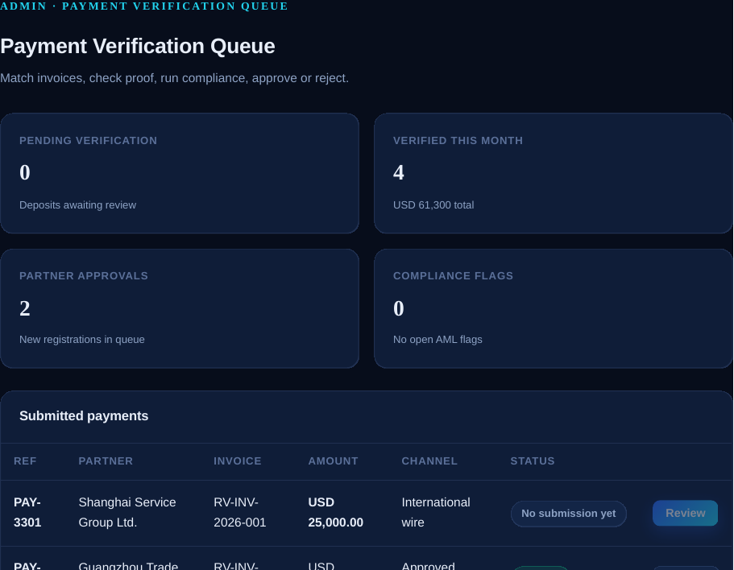
PRODUCT · REVOZON INTERNAL
Admin verification: nothing moves without review
Admin verification flow
1
Payment submitted
2
Finance review
3
Gateway / bank confirmation
4
Compliance check (KYC/KYB · AML)
5
Approve or reject
6
Notify partner
Payment verification queue — match invoice, check proof, approve or reject
7
Activate service delivery
Plus: KYC/KYB queue · project & milestone management · document generation · refunds & credits · support console · immutable audit log.
REVOZON TECHNOLOGY · Prototype documentation — no real payment processing
11

Slide 12

SECURITY & COMPLIANCE
Verification, documentation, operational transparency
KYC / KYB Verification
AML Screening
Secure Processing
Registration, license, tax info, representative checks before any invoice
Partners and payments screened as part of every verification cycle
Approved gateways and banking channels only — no informal routes
Data Protection
Role-Based Access
Audit Trail
Encrypted documents, agreements, and payment records
Partner, finance, compliance, and delivery roles separated
Every status change logged and reviewable
Disclaimer: intended for legitimate business-service payments only. All payment flows, gateway integrations, tax treatment, FX handling, and settlement must be reviewed by licensed legal, tax, banking, and compliance professionals before production launch.
REVOZON TECHNOLOGY · Prototype documentation — no real payment processing
12

Slide 13
FROM PROTOTYPE TO PRODUCTION
A staged, compliance-gated launch plan
1
2
3
4
Legal & Regulatory Review
Acquirer / PSP Onboarding
Gateway Certification
Pilot Partners Go Live
Licensed counsel signs off on cross-border service-payment model for China ⇄ Pakistan corridors.
Contract a UnionPay-certified acquirer: merchant ID, keys, settlement currency, refund policy.
Sandbox integration of createOrder / webhook / queryOrder / settlement; penetration & UAT testing.
Onboard 3–5 verified Chinese partners; full KYC/KYB; first invoiced projects with milestone delivery.
The prototype already demonstrates every state, screen, and integration point the production build requires.
REVOZON TECHNOLOGY · Prototype documentation — no real payment processing
13

Slide 14
Revozon Technology
Fund. Manage. Receive — verified.
Secure invoicing · Compliant payment coordination · Transparent project delivery · UnionPay-ready for Chinese partners
Start Partner Onboarding
Request Proposal
View Live Prototype
partners@revozontechnology.example (placeholder) · +92 ··· ··· ···· (placeholder) · WeChat / WhatsApp (placeholder) · Lahore · Shanghai liaison
This deck describes a clickable prototype. No real payment processing occurs. All payment flows, gateway integrations, tax treatment, FX handling, and cross-border settlement must be reviewed and approved by licensed legal, tax, banking, and compliance professionals before production launch.

